Slide 1
Web vibration FFT analysis- short temporal and spatial windows
10.07.2020

Slide 2
Short temporal window for FFT

Slide 3
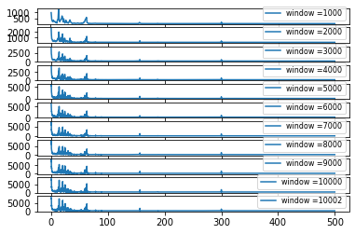
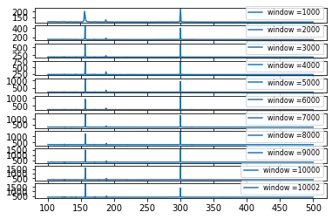
300 Hz
Original signal: 10002 data points

Slide 4
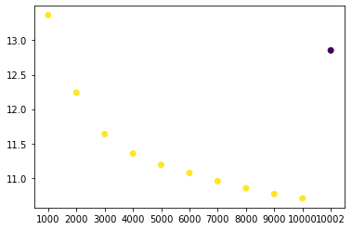
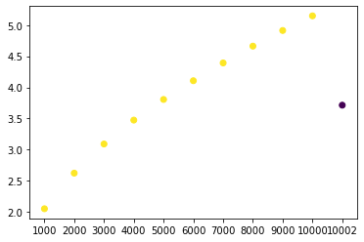
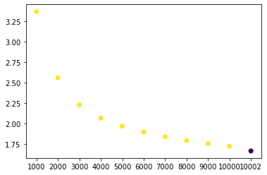



The signal to noise ratio
within 200-400Hz
$$SNR= \frac{mean}{std}$$
$$SNR= \frac{peak value}{mean}$$
$$SNR= \frac{peak value}{variance}$$
Two problems:
The original signal looks weird…
SNR is not a good method to see whether the FFT capture frequency?
The std and variance are small for shorter time window.

Slide 5
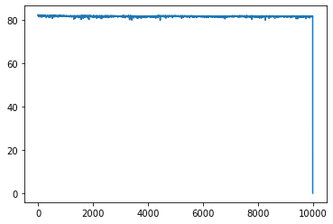
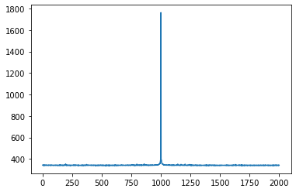
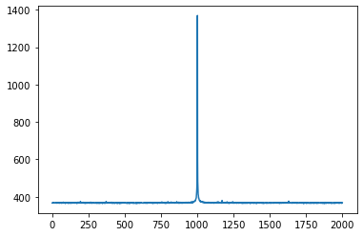
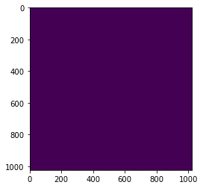
First problem: the original data
Original data
Two problems:
The original signal looks weird…
SNR is not a good method to see whether the FFT capture frequency?
The std and variance are small for shorter time window.
The last data point is zero.. So I remove it
Short time FFT
t = 0-10000
t = 0-10002
Last frame in the original data
200
400
200
400
Frequency (Hz)
Frequency (Hz)

Slide 6
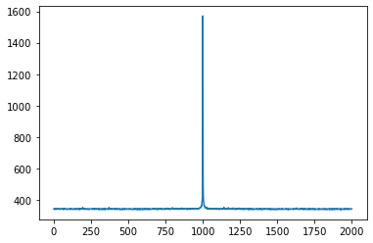
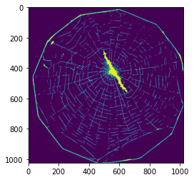
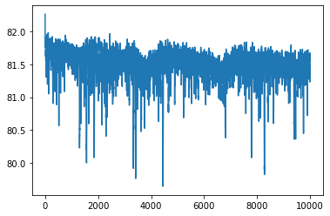
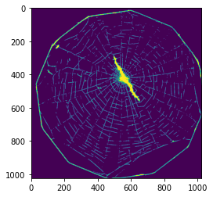
First problem: the original data
Short time FFT
T=0:10000
T=0:10001
dataFFT = np.abs(scipy.fft(data[res[0], res[1], :-1]))
dataFFT = np.abs(scipy.fft(data[res[0], res[1], :]))
200
400
200
400
Original data
T=9999
T=10000 (last frame after removing)

Slide 7
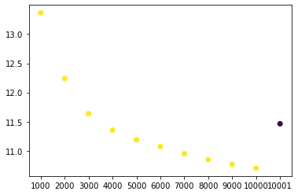
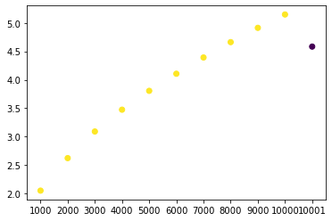
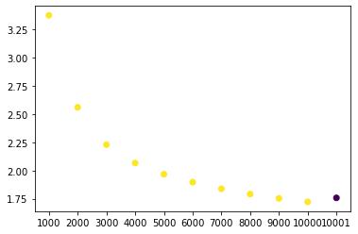
The signal to noise ratio after removing
200-400HZ
$$SNR= \frac{mean}{std}$$
$$SNR= \frac{peak value}{mean}$$
$$SNR= \frac{peak value}{variance}$$
Two problems:
The original signal looks weird…
SNR is not a good method to see whether the FFT capture frequency?
The std and variance are small for shorter time window.
It’s better but still strange..

Slide 8
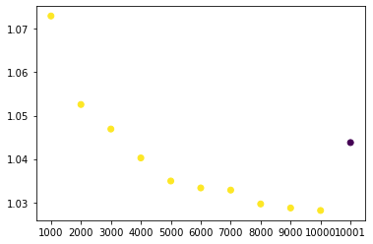
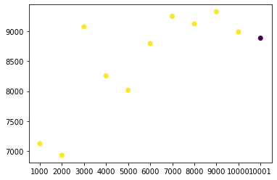


$$SNR= \frac{mean(signal>mean)}{mean(signa≤mean)}$$
$$SNR= \frac{var(signal>mean)}{var(signa≤mean)}$$

Slide 9
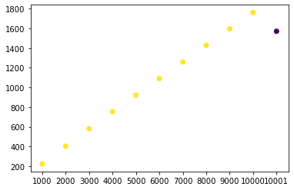
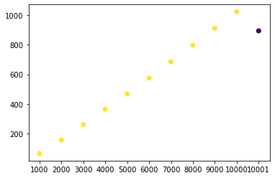
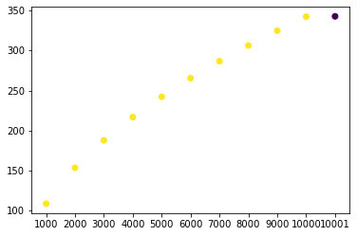



Problem 2: SNR
$$SNR= \frac{mean}{std}$$
$$SNR= \frac{peak value}{mean}$$
$$SNR= \frac{peak value}{variance}$$
Peak
variance
mean

Slide 10

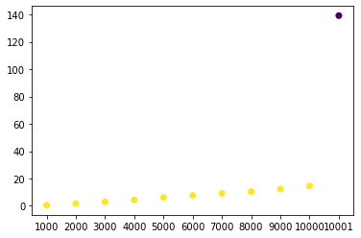

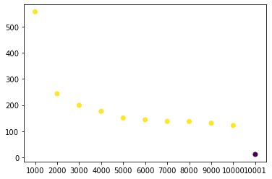


Problem 2: SNR
mean
variance
This looks weird
$$SNR= \frac{peak value}{mean without peak}$$
$$SNR= \frac{peak value}{variance without peak}$$
This looks good

Slide 11
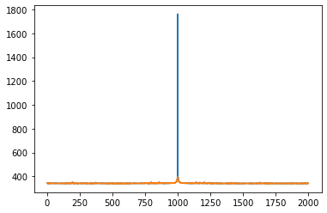
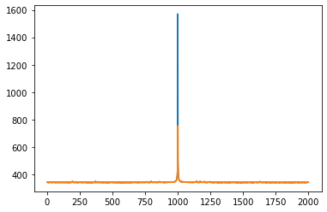
First problem: the original data
Short time FFT
T=0:10000
T=0:10001
dataFFT = np.abs(scipy.fft(data[res[0], res[1], :-1]))
dataFFT = np.abs(scipy.fft(data[res[0], res[1], :]))
So there’s a second peak round 300 Hz for the whole time series
This is why we got the results shown in the first part
But why does the last frame cause such a big difference?
Try 400 Hz to see whether it is also weird
200
400
200
400
FFT without removing the peak
FFT removing the peak
200
400
200
400

Slide 12
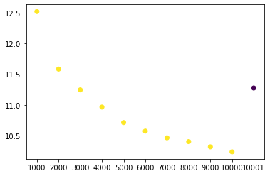
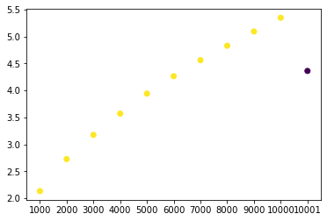
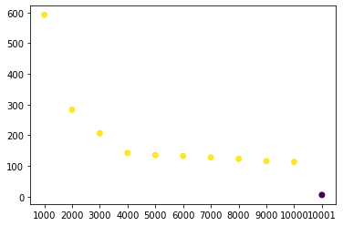
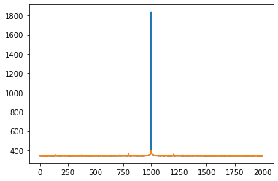
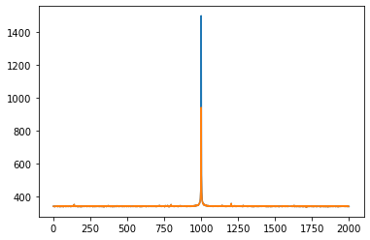



400 Hz
$$SNR= \frac{peak value}{mean without peak}$$
$$SNR= \frac{peak value}{variance without peak}$$
$$SNR= \frac{mean}{std}$$
T=0:10000
T=0:10001
300
500
300
500

Slide 13
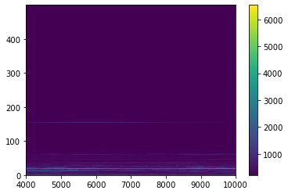
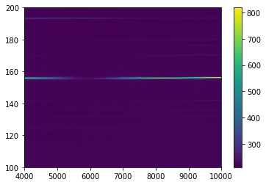
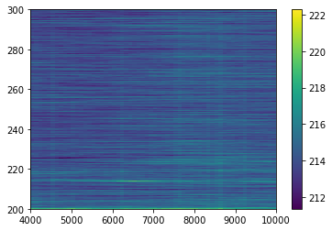
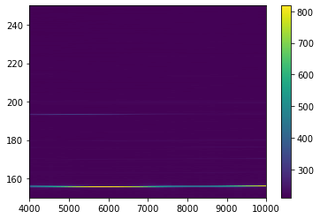
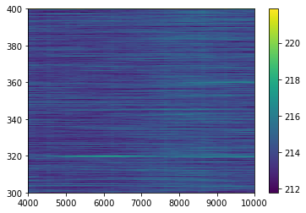
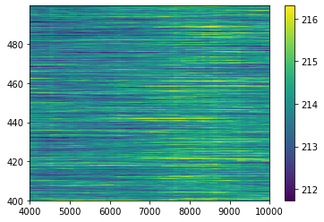
STFT-200 Hz video with window size= 4000, step = 100

Slide 14
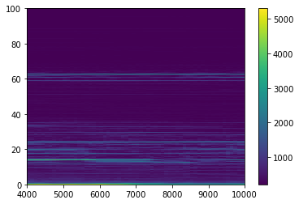
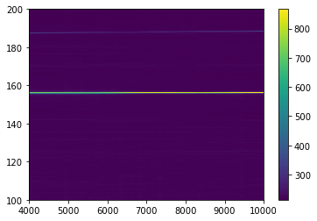
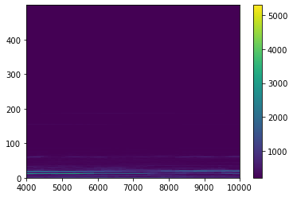
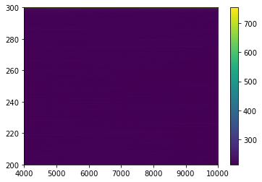
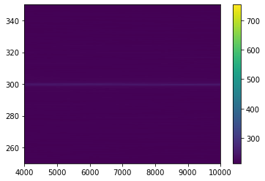
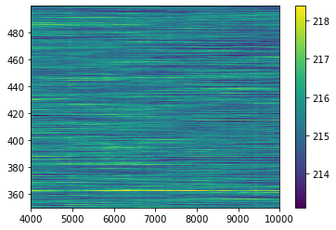
STFT-300 Hz video with window size= 4000, step = 100

Slide 15

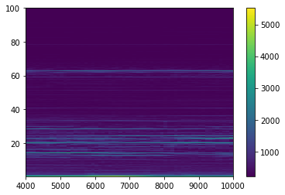
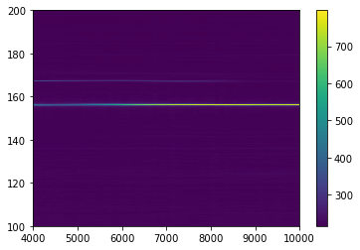
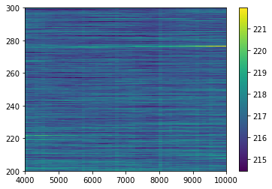

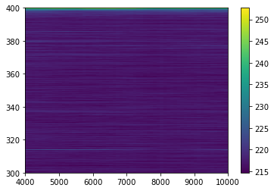
STFT-400 Hz video with window size= 4000, step = 100
frequency
frames

Slide 16

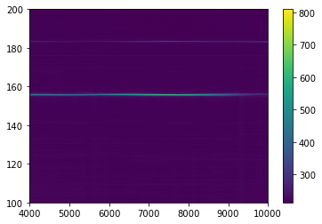
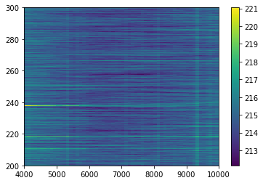
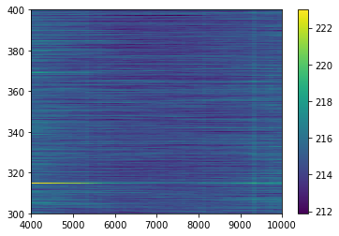
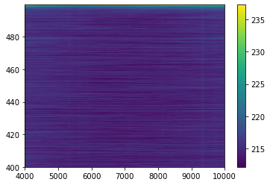
STFT-500 Hz video with window size= 4000, step = 100
frequency
frames

Slide 17
Spatial window for FFT

Slide 18

200 Hz (with threshold =20)

Slide 19

300 Hz (with threshold =20)

Slide 20

400 Hz (with threshold =20)

Slide 21

500 Hz (with threshold =20)

